Slide 1

Design and Development of a RAM-based PUF
Zissis Tabouras (s284685)
Elena Roncolino (s304719)
Stefano Palmieri (s281677)

Slide 2
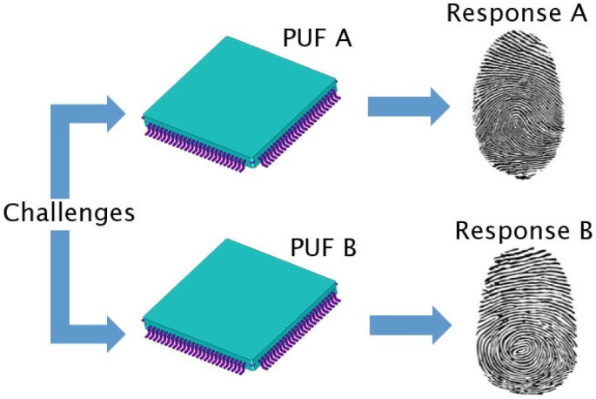
What is a PUF?

Slide 3
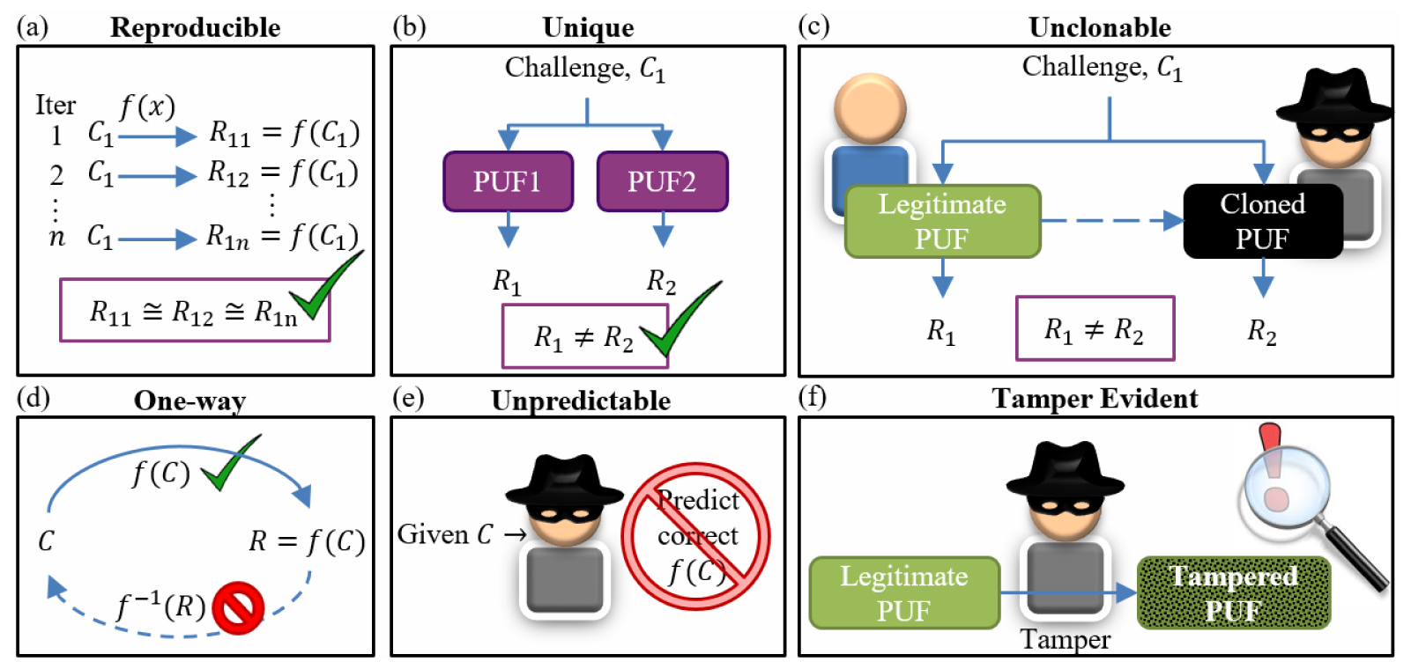
Why PUF is important?

Slide 4
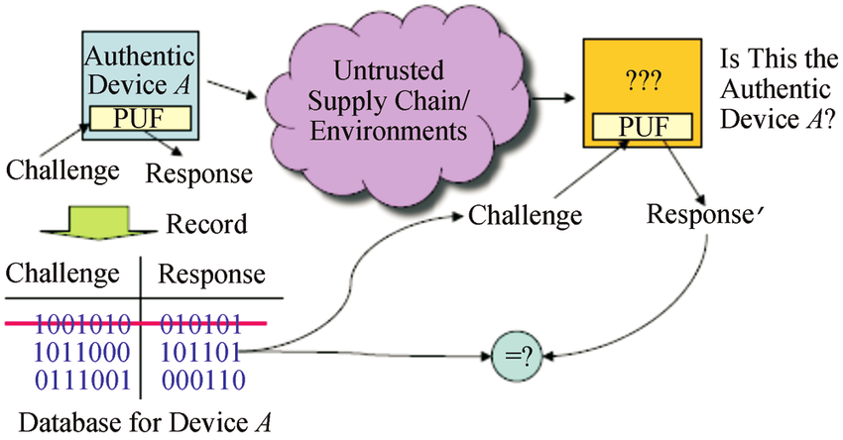
How PUF works?

Slide 5
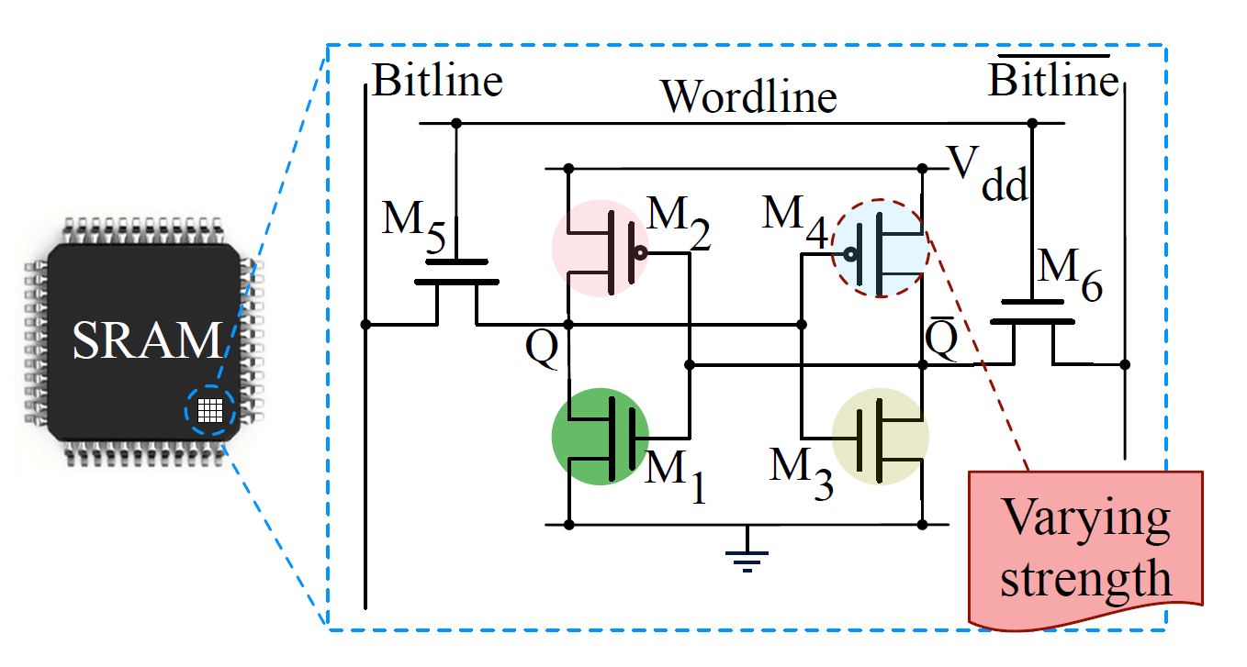
Which PUF implemented?

Slide 6
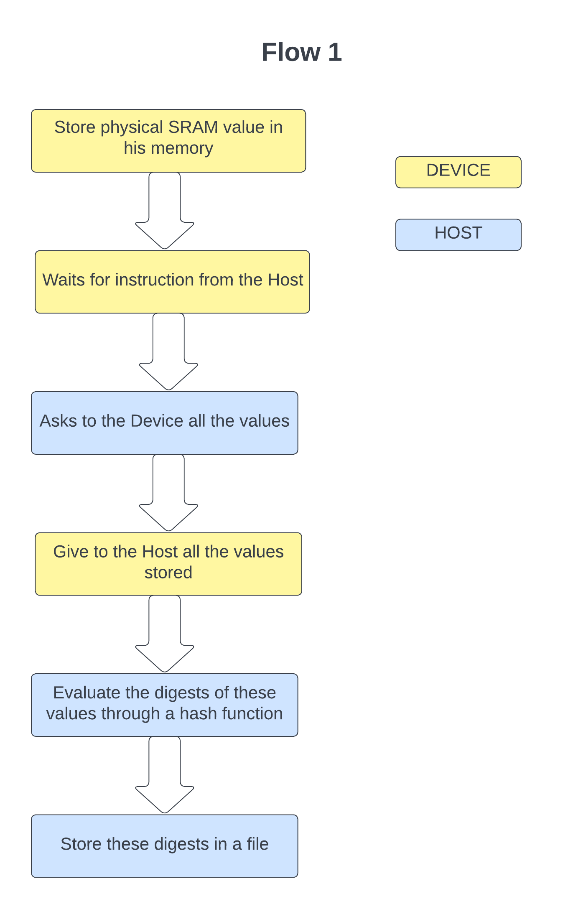
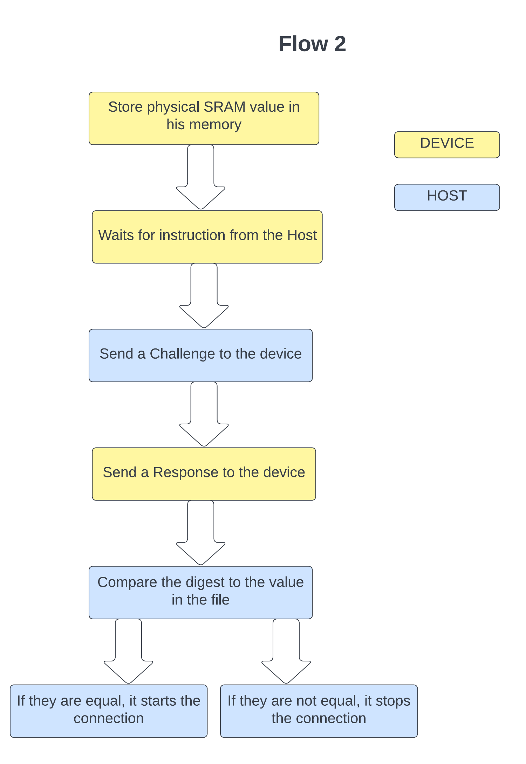
Implementation

Slide 7


PUF retrieval and DB initialization
Store SRAM content into flash memory
Access flash memory to retreive PUFs and populate DB
Apply challenge to authenticate device
“Probably a schematic representation of the communication”
1

Slide 8
Task partitioning
Host
Request list of PUFs
Receive PUF list
Store the list in a DB
Board
Store SRAM content in FLASH(startup)
Send list of PUFs

Slide 9
Application of a challenge and verification of device authenticity
Apply challenge to DB and board
Retreive board response
Perform response matching
“Probably a schematic representation of the communication”
1

Slide 10
Task partitioning
Host
Generate challenge
Send challenge to Board and DB
Compare responses (Hamming)
Board
Receive challenge
Send response

Slide 11
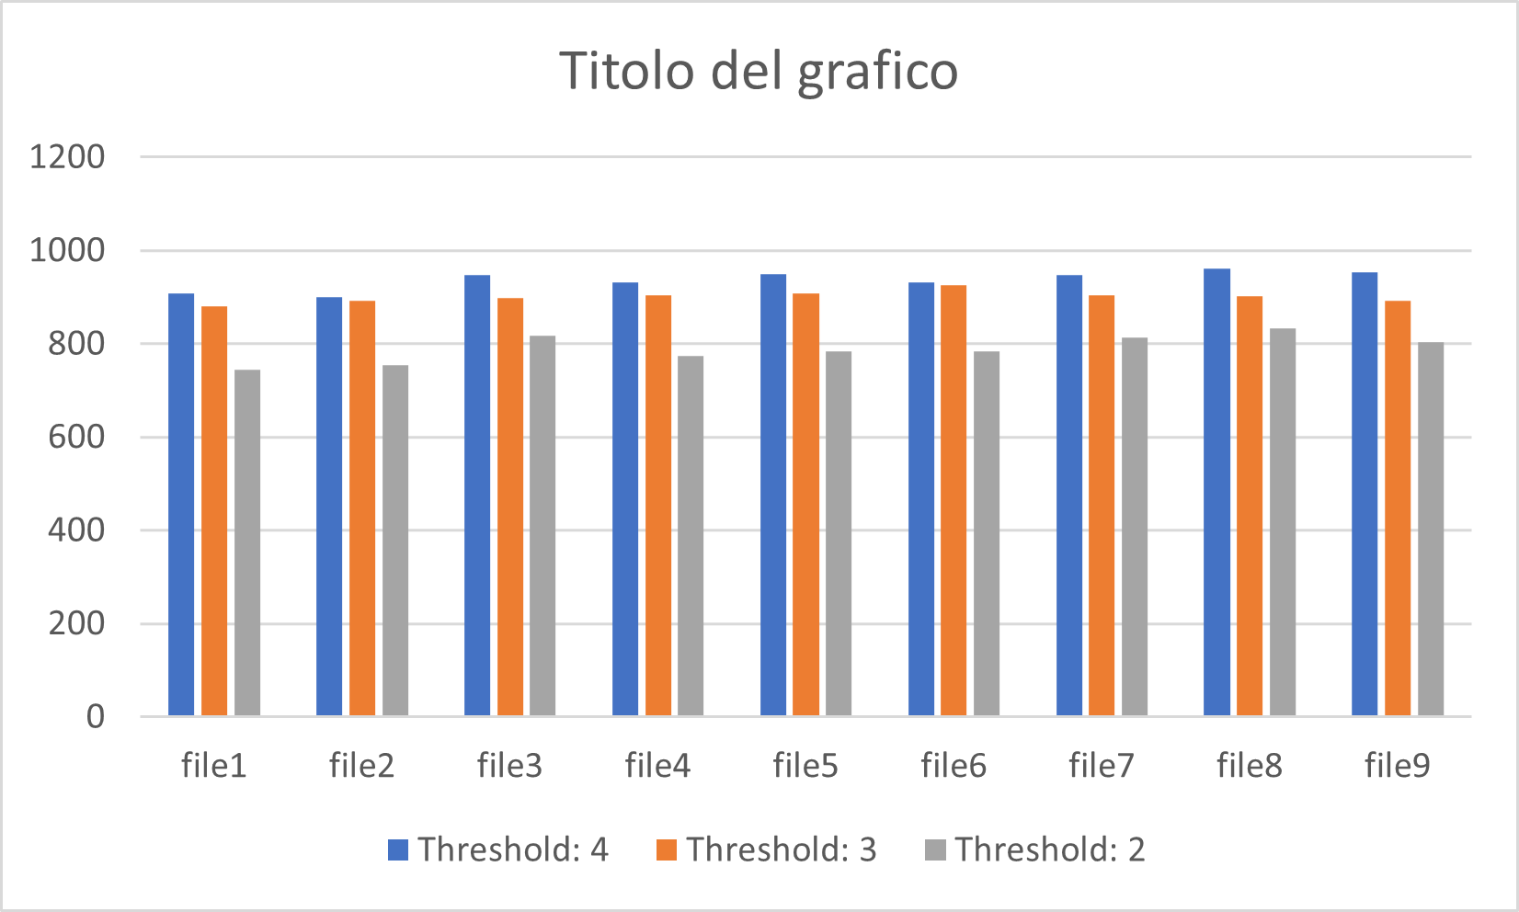
Results

Slide 12
Example on the board

